Slide 1
Deployment

Slide 2
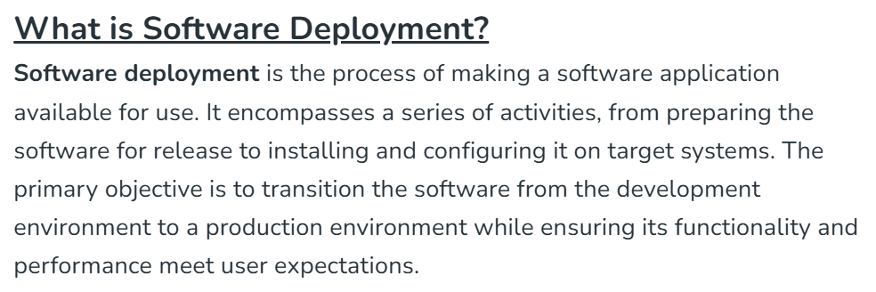

Slide 3
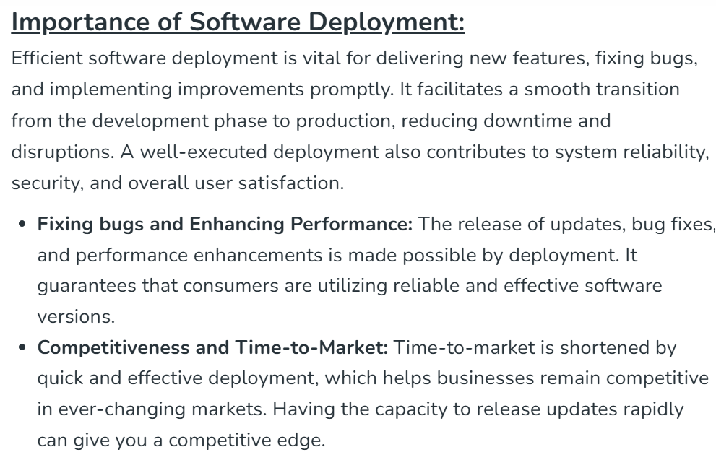

Slide 4
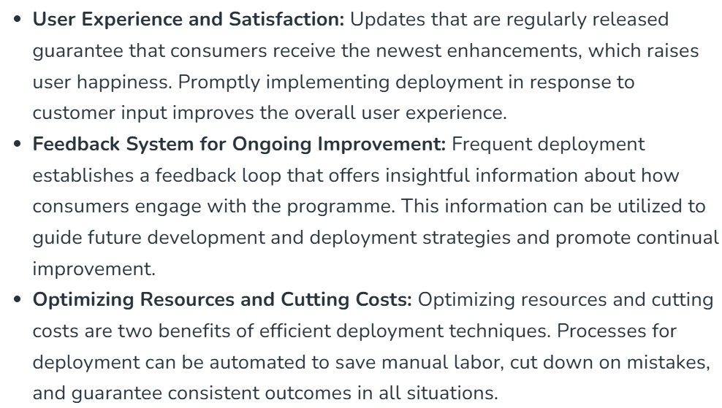

Slide 5
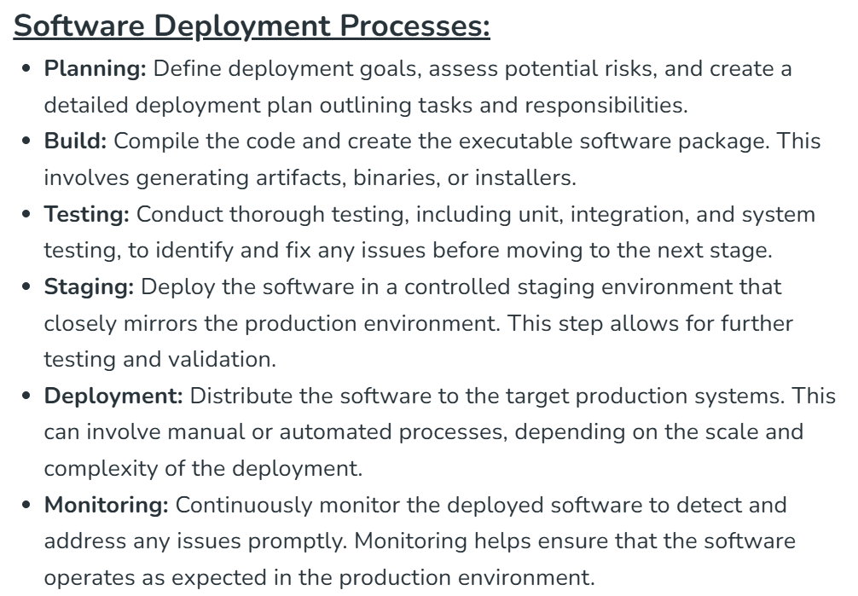

Slide 6
Deployment Rollback
A deployment rollback is a process used in software development and IT operations to revert an application or system to a previous, stable version. This is typically done when a recent deployment introduces bugs, errors, or performance issues that cannot be resolved quickly in the live environment.

Slide 7
